Slide 1

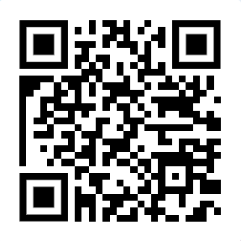
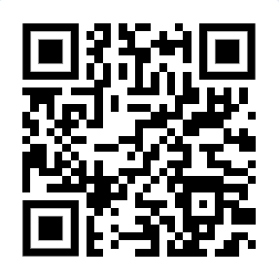
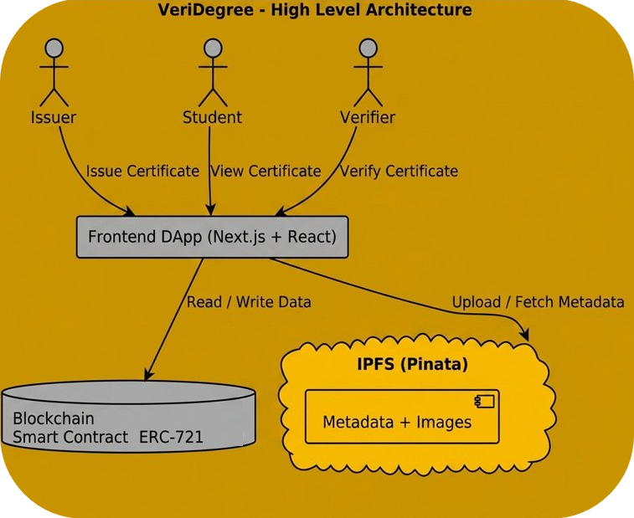

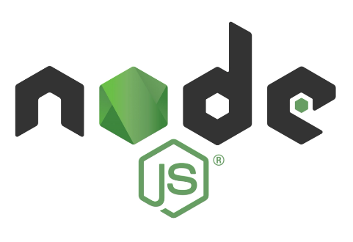

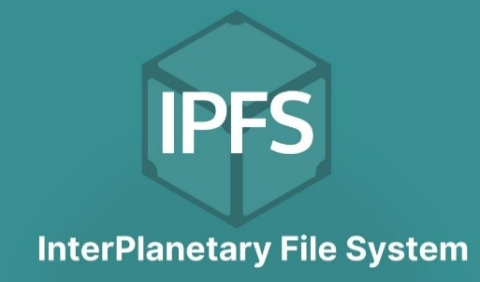

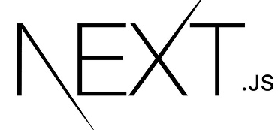



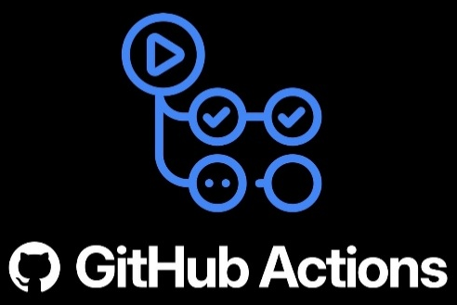


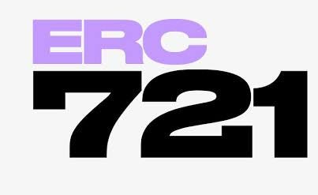


VeriDegree
Eskandar Atrakchi, BSc (Honours) in Computing
Overview
VeriDegree is a (Dapp) that gives power to institutions to issue tamper-proof academic certificates using blockchain. Minting generates a non-transferable NFT stored on IPFS, enabling students to view and verify from their wallet. This system removes the need for manual verification and prevents fraud.
Motivation
Credential fraud is growing problem worldwide. Traditional credentials are PDF or paper form can easily be altered, and verification requires manual communication with institutions makes the process slow and inefficient. VeriDegree addresses this problem by creating an immutable digital certificate and true ownership.
GitHub ➔
⬅ Web-DApp
How it Works
The system enables institutions to issue certificates as soulbound NFTs on IPFS and the blockchain. Students can view their certificate through their wallets, while employers can instantly verify authenticity by entering the public wallet address.
Technologies

